Slide 1

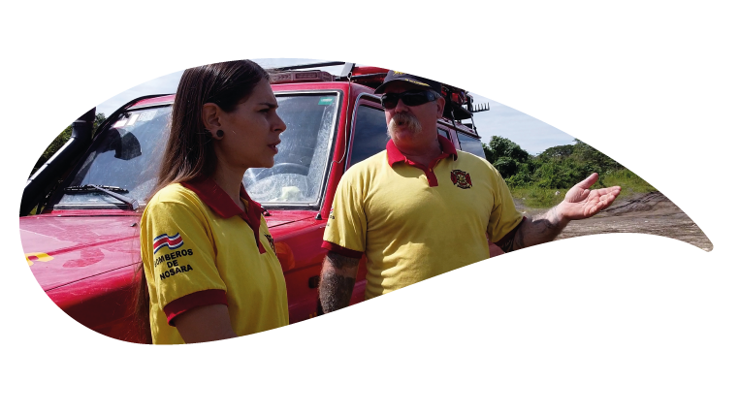
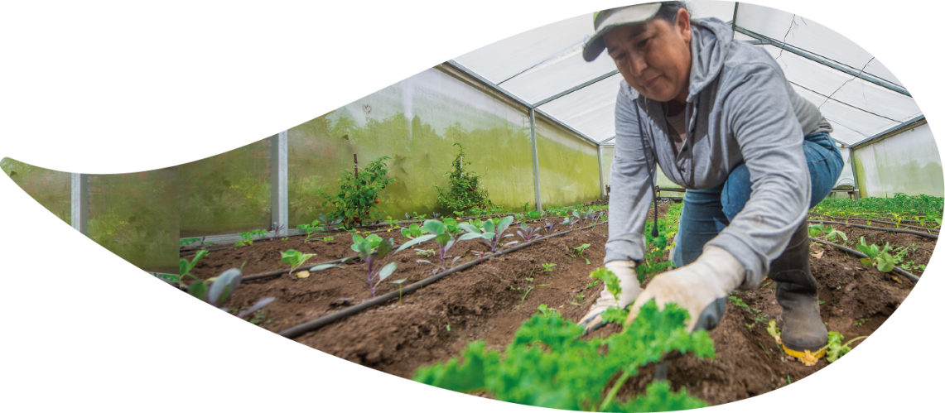
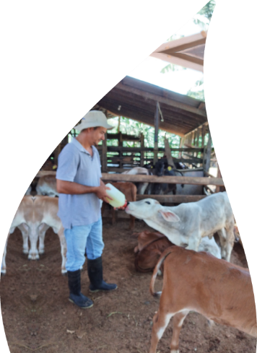




Empowering the most vulnerable, women, youth, elderly, indigenous populations, and incorporating local and traditional knowledge
Marianella Feoli
Fundecooperación para el Desarrollo Sostenible

Slide 2

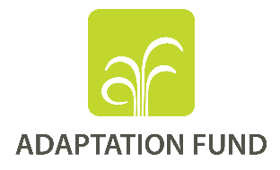
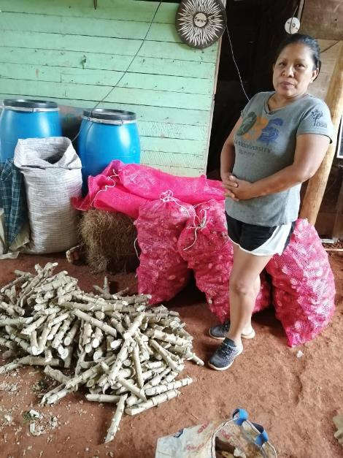
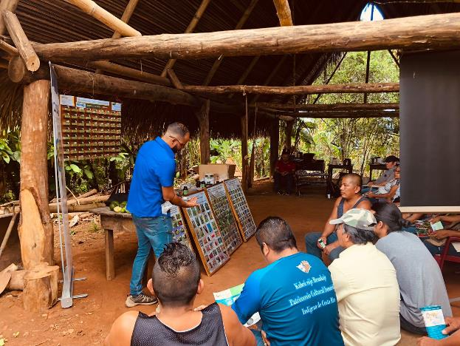
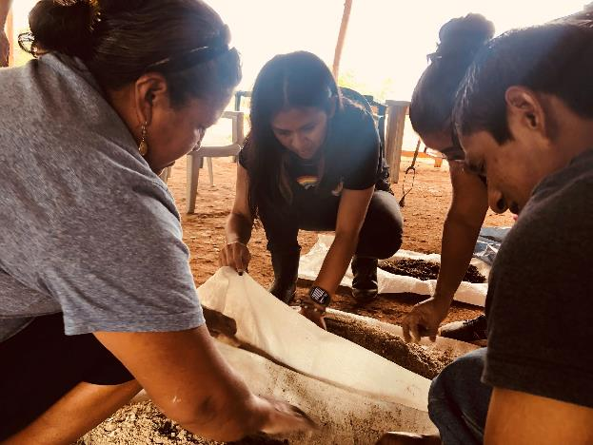
Traditional knowledge exchange and involvement of women and youth.
Generational integration.

Slide 3

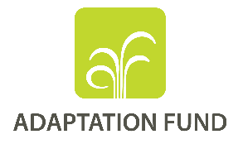
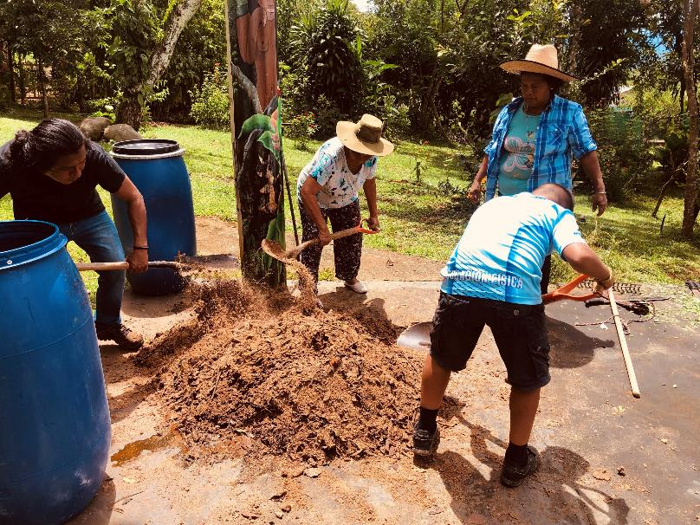
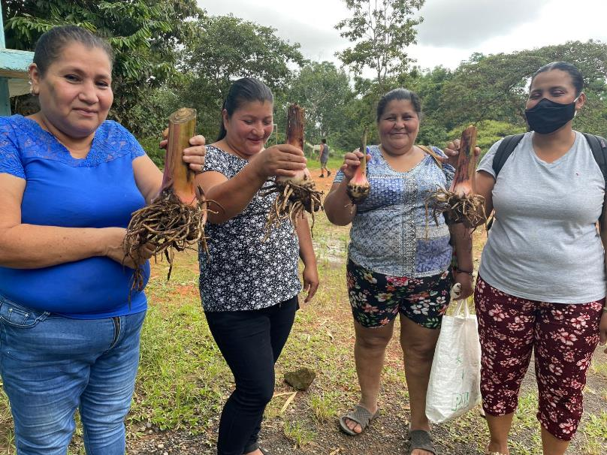
Rescue of ancestral practices, i.e. bio-inputs, diversified food crops (including local varieties)

Slide 4
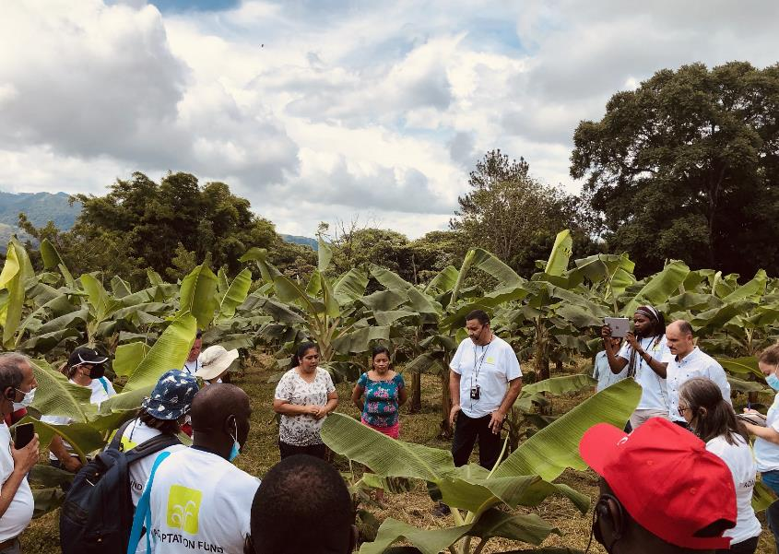
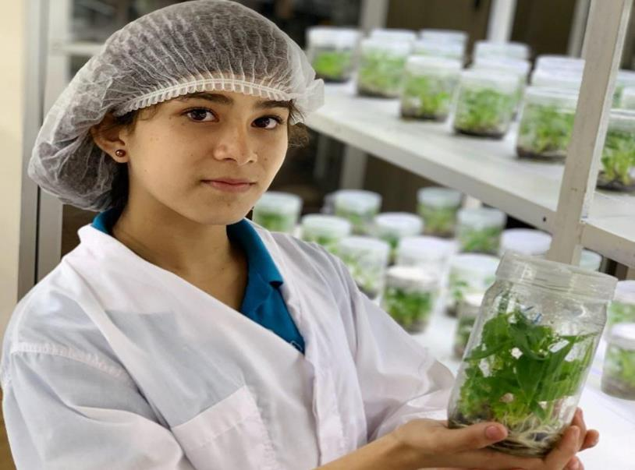
Seed reproduction and carefull material handling: local youth involvement in biotechnology, rescuing, “cleaning” and reproducing local genetic material

Slide 5
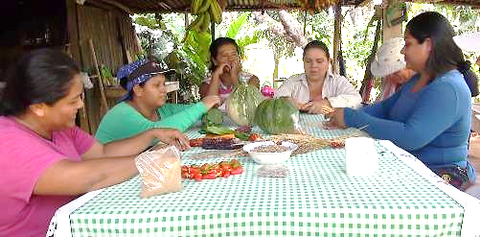
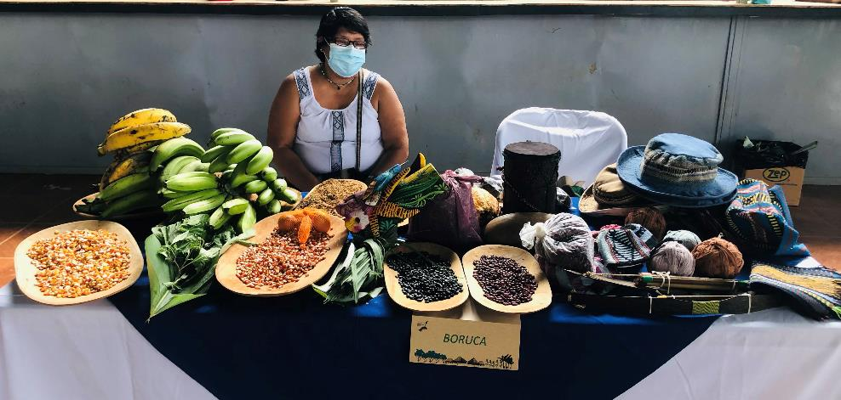
Local seed management and exchange among indigenous communities

